Slide 1
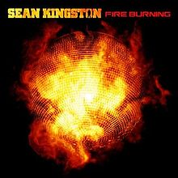
Wildfires! Are! Hot!
Jacob Paul | Hannah Weber | Marissa Kelley
INFO 4604
12.18.18
Notes:
HANNAH

Slide 2
The Problem
U.S. wildfire losses during the past 10 years have totaled $5.1 billion (Verisk Analytics)
Roughly 4.5 million U.S. homes are at high or extreme risk of wildfires
Fires can burn extremely hot and destroy ALL vegetation
Can cause erosion which degrades stream water quality
Ways to start a fire:
A glass bottle thrown on the side of the road magnifies a ray of sunlight, igniting grass around it.
Kids playing with matches inadvertently start a fire.
A campfire is not properly extinguished and spreads.
Sparks from a train ignite grass around the tracks.
A controlled burn gets out of control.
Fireworks set a nearby tree on fire.
A cigarette isn't put out and catches a patch of dry grass on fire.
https://www.thewildlifemuseum.org/exhibits/burning-for-wildlife/negative-effects-of-wildfire-on-wildlife/
Notes:
MARISSA

Slide 3
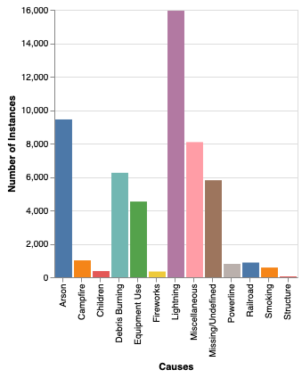
Significance
Predict the causes of the wildfires before they happen
Look via the context of the different states
Help locals be prepared
Help the firefighters be ready with the necessary resources
Provide education and awareness of causes and prevention
Notes:
HANNAH
Resources: Location, tools, etc.

Slide 4
Dataset
https://www.kaggle.com/rtatman/188-million-us-wildfires/home
How it was collected:
Spatial database of wildfires that occurred in the US from 1992-2015
Originally generated to support the national Fire Program Analysis (FPA) system
Preprocessing:
Pulled data out of SQL database
Narrowed instances down to 54,000 from 1.88 million by filtering based on the size class (fires 100 acres and larger)
Notes:
JACOB

Slide 5
Features
40 original features
12 features after dropping features that contained ID numbers or null values
Feature | Description
NWCG_REPORTING_AGENCY | National Wildlife Coordinating Group (NWCG) Unit Identifier for the agency preparing the fire report
FIRE_YEAR | Year that the fire was discovered
DISCOVERY_DOY | Day of the year that the fire was discovered
FIRE_SIZE | Size of the fire in acres
FIRE_SIZE_CLASS | Size of the fire by category
LATITUDE/LONGITUDE | Geolocation of the fire
OWNER_DESCR | Owner agency of the fire (USFS, BLM etc.)
STATE | State that the fire was located in
STAT_CAUSE_DESCR | Cause of the fire (what we are trying to predict)
Notes:
JACOB

Slide 6
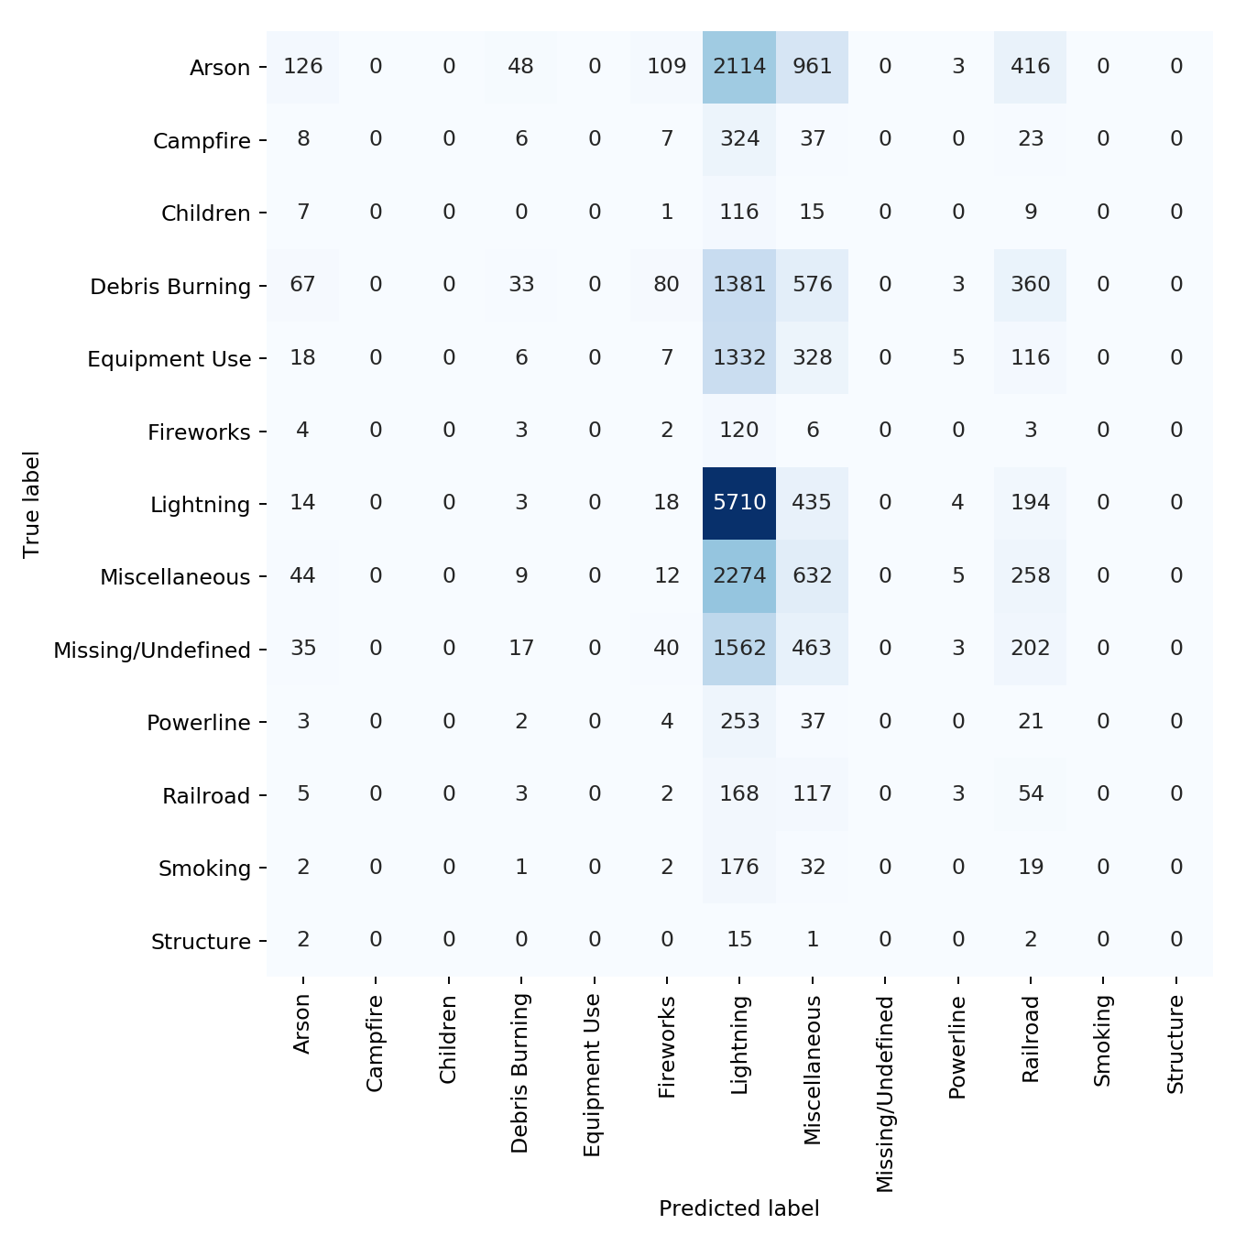
Algorithm 1- Perceptron
Test accuracy - 0.303
Precision score - 0.093
Best Hyperparameters:
Learning rate (eta0) - 0.3
Iterations (n_iter) - 500
Highest predicted cause - Lightning
Highest feature weights:
Longitude - 54051
Florida - 52985
Oklahoma - 52616
Notes:
HANNAH
Test accuracy was very low
Precision score also low (only 9%)
This was our worst performing algorithm
Learning rate - goal is to find the minima and the learning rate helps us determine how fast we find that; too big means you can overshoot, too small takes too long to converge, 0.3 close to the middle
Iterations - helps the classifier fit the data; too big means you are likely to overfit, too small and it will underfit; 500 iterations worked well on the homework #1 and so I used it on this data

Slide 7
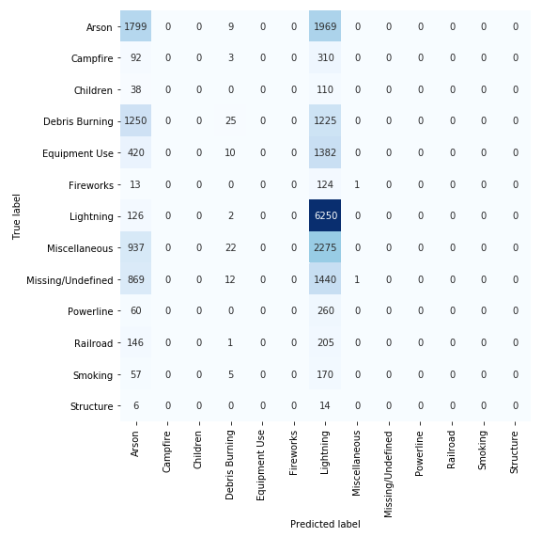
Algorithm 2- Logistic Regression
Test Accuracy: 0.551
Precision Score: 0.284
Best Hyperparameters:
Multiclass: Multinomial
Solver: 'lbfgs'
Random State: 123
Highest predicted cause: Lightning
Highest Feature Weights:
Delaware: 9.292502151752619e-08
New York: 9.81
NWCG Reporting Agency BIA: 8.919
Notes:
MARISSA
Multiclass: uses the cross- entropy loss, that’s supported by the lbfgs solver
Solver: gives you the L2 regularization
Random state: ensures that you don’t get a different result each time you run the code

Slide 8
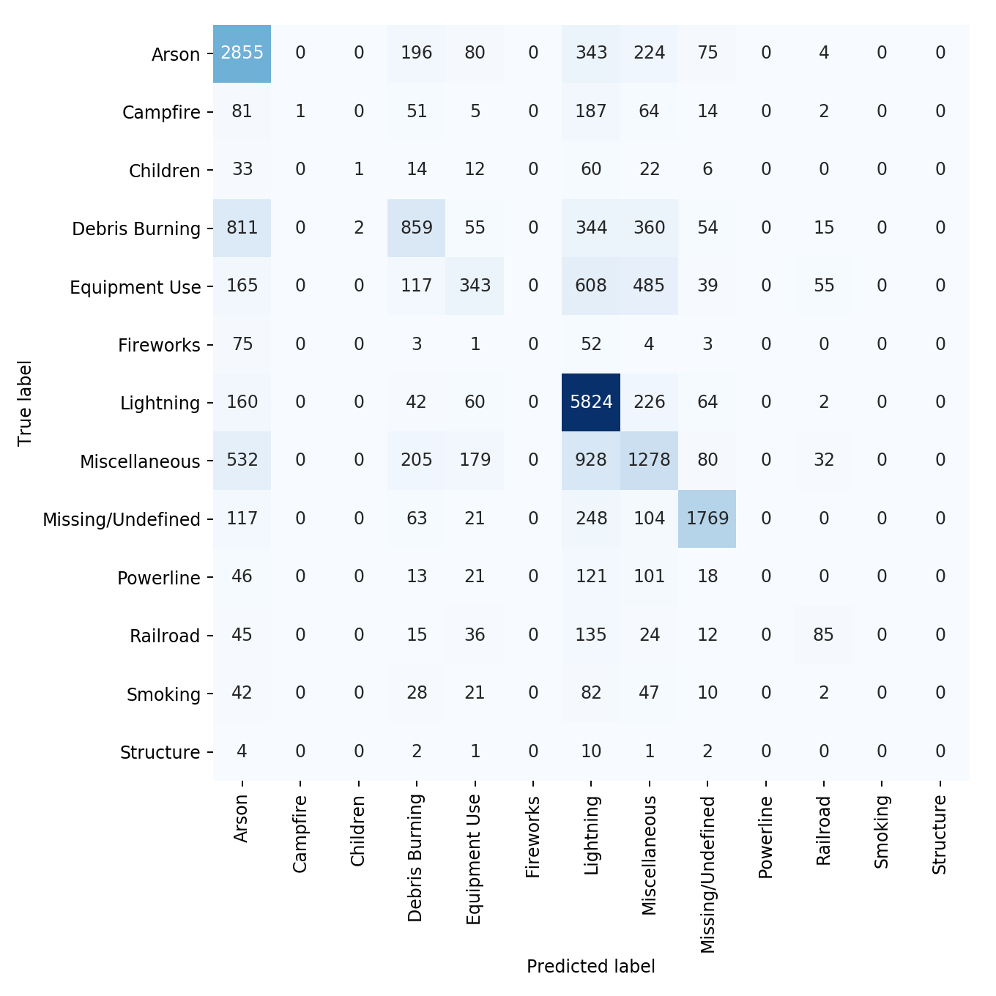
Algorithm 3- Random Forest
Test accuracy: 0.6033
Precision: 0.3590
Best Hyperparameters:
n_estimators=100
max_depth=100
min_samples_leaf=5
random_state=123
Highest predicted cause: Lightning
Highest feature weights:
Longitude/Latitude
Discovery Date
Containment Date
Notes:
JACOB - https://www.stat.berkeley.edu/~breiman/RandomForests/cc_home.htm#micro

Slide 9
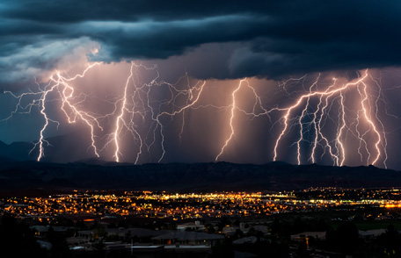
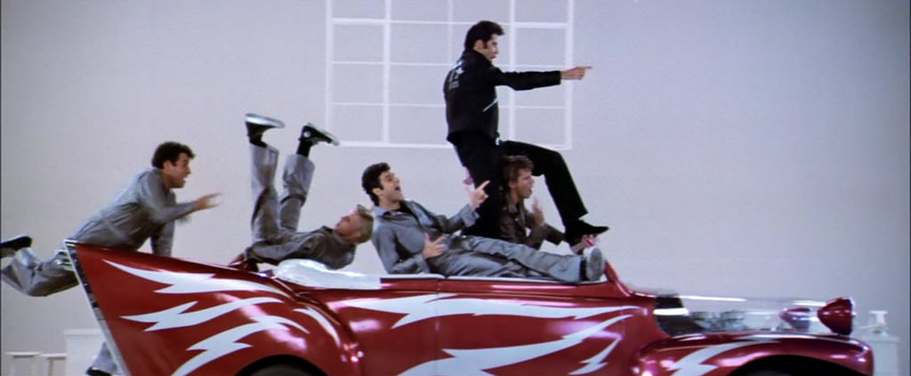

Overall Results
Lightning and Arson were the most predicted causes
All classifiers had trouble classifying between the different human-related causes
Ranking of Classifier Performance
Random Forest
Logistic Regression
Perceptron
Notes:
MARISSA
Many instances were incorrectly predicted as Lightning
All 3 classifiers did not predict any instances for campfire, children, structure or smoking
Normalizing the data had little effect on accuracies

Slide 10
Feature Selections & Constraints
Inclusion of the ‘COMPLEX_NAME’ greatly improves test accuracy but there are many NA instances that need to be dropped.
Calculating burn time (date contained - date discovered) does increase accuracy slightly
Constraints:
Overall quality (not all columns were completely filled out→ limits our data
Notes:
JACOB

Slide 11

Questions?
https://github.com/marissa-kelley/4604-wildfires-are-hot
Notes:
HANNAH

